Slide 1
Session 1: Relevance, quality, and timeliness as drivers for uptake of EUnetHTA’s work

Slide 2
Status of implementation – where are we now
Nick Crabb, National Institute for Health and Care Excellence, Programme Director Scientific Affairs
EUnetHTA Forum 25th May: Cologne
Notes:
Title slide orange

Slide 3
Methods of data collection
Data about use of the EUnetHTA assessments is collected through the EUnetHTA Intranet using a survey
The surveys are available on a continuous basis for partners to describe their use of the EUnetHTA assessments
Survey data is downloaded at regular intervals for implementation reports
Some survey entries are followed up using semi-structured interviews to gather more in-depth information
The first 5 EUnetHTA assessments have been followed up for 6-12 months:
  the response rate per assessment is between 66% and 86% of EUnetHTA partner countries
  forty-six examples of use have been reported: 21 for pharmaceuticals and 25 for other technologies
Notes:
Surveys can be updated and amended if work status changes.
Data will also be used in the WP3 JA3 evaluation
Verbal update on latest data to be given at event – it will be about 42 for the first 5 assessments

Slide 4
Type of use captured in data collection
The survey aims to capture a broad range of types of use including:
  use as part of or instead of national, regional or local assessment, and
  dissemination practices to raise awareness of EUnetHTA assessments and evidence informed decision-making
Three elements of use are measured:
  How the assessment was used?
  Scale of the changes made to the assessment?
  What information was added?
The elements to be measured were defined in a metrics tool developed collaboratively by EUnetHTA and subject to consultation with partners

Slide 5
Implementation status

Slide 6
Implementation status of the first 5 JA3 assessments
Assessment | Did not use | Used in assessment procedures | Dissemination of the EUnetHTA assessment | Total number of uses reported
OTC01: Wearable cardioverter-defibrillators | 2 | 4 | 5 | 9
OTCA02: Antibacterial-coated Sutures | 1 | 4 | 3 | 7
OTCA05: Transcranial magnetic stimulation | 7 | 3 | 6 | 9
PTJA01: Midostaurin for Acute Myeloid Leukaemia | 5 | 8 | 2 | 10
PTJA02: Regorafenib for hepatocellular carcinoma | 3 | 9 | 2 | 11
In 12 of the 18 instances of non-use, the EUnetHTA report was not available when the agency did their work on the topic
Data downloaded May 17th 2018
Notes:
Underline – still too early to have captured all use that will occur – Pharma launch likely to be staggered over about 12-18 months, and for other technologies national implementation of JA2 assessments was across approximately 2-3 years.
Agencies only included once so if an agency did both use as part of national assessment and dissemination it will be counted once under use as national assessment e.g. agencies using as part of dissemination are different to those using as part of national assessment
The other cases of non-use:
3 not aware the assessment was being done (worrying)
1 relevance
2 a mixture of reasons including methodology used was out with the approach adopted by the agency; The EUnetHTA assessment was not of sufficient quality; The scope of the national assessment was different; and transparency of process and availability of documents.
Two types of use of EUnetHTA assessments were reported: (1) use to support or as an alternative to the agency’s existing HTA procedures and (2) use as part of dissemination to support awareness of EUnetHTA assessments and evidence informed decision-making. Dissemination practices reported include inclusion of the EUnetHTA assessment in databases of evidence sources for providers, summaries and analysis for decision makers and websites; inclusion in newsletters to stakeholders and direct dissemination to clinicians.

Slide 7
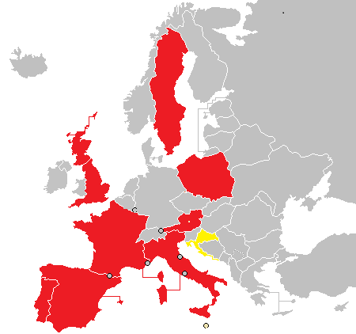
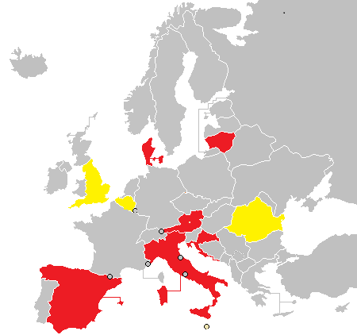
Countries reporting use of the first 5 EUnetHTA assessments
Pharmaceuticals
Other technologies
Red = reported use in assessment activities Yellow = reported dissemination activities only
9 countries report use of pharmaceutical reports in assessment procedures (+1 country dissemination only)
6 countries report use of other technologies reports in assessment procedures (+3 countries dissemination only)
Notes:
Updated data: for first 5 assessments – Italy doing national adaptations non-pharma, Romania dissemination of non-pharma
In addition, Norway and The Netherlands and Belgium report using the later EUnetHTA assessments (these haven’t been formally followed up yet, because the time from publication is too short) of alectinib (Norway) and Mammaprint (Netherlands, Belgium).
For pharma the pattern of country involvement is expected because companies launch first in the main markets before spreading out to the smaller and CEE markets
NICE is yellow for other technologies because EUnetHTA reports are all indexed in NHS evidence. NICE is red for pharmaceuticals because regorefenib was available while the appraisal was being completed and the analyst read through it and checked that a similar set of issues were being raised between the EUnetHTA and ERG report

Slide 8
Type of use reported so far
Among agencies using company submissions as a key source of evidence for an assessment (more likely pharmaceutical assessments), EUnetHTA reports are mainly used to support existing national procedures:
  As background information and additional information
  To check issues and support evaluation
  To extract elements for use in the national report
Among agencies producing own HTA from a range of sources (more likely other technologies assessments), EUnetHTA reports are more likely to replace national procedures:
  A national language summary with a link to the EUnetHTA report
When used to support national processes rather than replace them agencies often do not report resource savings

Slide 9
Limiting Factors
Agencies using the EUnetHTA assessments were asked whether any factors limited their ability to make use of the EUnetHTA assessment
Most frequently mentioned factors were timing of availability and national language and report structure requirements
Length of notice of an assessment being available, quality and transferability were not identified as limiting factors by users
Notes:
I have used EU REA as a shorthand for EUnetHTA assessment
This is a multiple choice question in the survey. Not mutually exclusive
Axis = number of agencies reporting the issue for per assessment e.g. the same agency might have used 3 EUnetHTA assessments and said there were no limiting factors for each adaptation and this would be counted 3 times.
Issues which no one chose have been removed and are mentioned in the last bullet point

Slide 10
Implementation findings in the context of WP7 research and analysis

Slide 11
Reminder aims and data received
The aim of the study was to analyse HTA and reimbursement processes in EUnetHTA partner countries and identify how within their existing processes agencies could:
      engage in EUnetHTA activities,
      use jointly produced EUnetHTA HTA information, and
      reuse national, regional and local HTA information from other jurisdictions.
Data were received from 59 agencies in 31 EUnetHTA partner countries.
  94% of countries (29/31) reported assessment procedures for pharmaceuticals
  71% of countries (22/31) reported assessment procedures for other technologies
Notes:
England, Scotland and Wales counted separately

Slide 12
Challenges identified: Topic selection
Issue identified in WP7 research and analysis | Issue identified in implementation data so far
Responsibility for topic selection includes multiple national and/or regional agencies, experts and stakeholders and may not include the HTA agency | Not a major issue in data: Topics identified by EUnetHTA so far seem to be relevant e.g. resulting in national use
Topics for assessment may not be known very far in advance of an assessment being required (limited predictability) | Yes: Few partners concretely indicate that work on the EUnetHTA topic is scheduled, but many say it could happen in the future
For other technologies there is lower levels of HTA capacity in many countries | Yes: Lower levels of use in assessment processes observed for other technologies, but dissemination of the EUnetHTA assessment is more likely to occur

Slide 13
Challenges identified: Timing
Issue identified in WP7 research and analysis | Issue identified in implementation data so far
For pharmaceuticals, some countries start work before marketing authorisation is granted timing of initiation is often dependent on company application agencies often have a relatively small amount of time to complete their work | Yes: Timing is a frequently cited reason for not using EUnetHTA assessments and is also a common factor cited as limiting use
For other technologies there is a particular issue to identify when an assessment will be timely for most agencies | Yes: Timing is the most frequently cited reason for not using EUnetHTA assessments
Notes:
Nick, note that for pharmaceuticals timing is no longer the most common factor for non-use (equally common with awareness)

Slide 14
Challenges identified: Assessment production
Issue identified in WP7 research and analysis | Issue identified in implementation data so far
Question to be addressed in an HTA may not be defined by the HTA agency | Not a major issue in data: EUnetHTA assessment scopes have generally been relevant to partners – though it is an issue identified by some partners
For pharmaceuticals the product created is most often an evaluation of a company submission not an HTA | Yes: EUnetHTA assessments more often support national processes rather than replace them
For countries using cost effectiveness analysis relying on relative effectiveness and economic data from different sources introduces risk to the assessment | Not an issue identified: EUnetHTA assessments mainly being used as supportive of national processes
Companies and agencies may focus on a subgroup for assessment purposes rather than the full authorised population | Not an issue identified: EUnetHTA assessments mainly being used as supportive of national processes

Slide 15
Issues raised
What is a reasonable expectation for implementation, for JA3? post 2020?
  Use to support existing agency procedures; or
  More challenging use as an alternative to agency procedures?
Is it possible to refine EUnetHTA reports so that where used to support national procedures this results in resource savings?
If agencies only use reports to support national procedures, is there a danger that relevant post 2020 issues will not be fully revealed?
How can topic selection processes best ensure topics chosen and questions to be addressed are relevant and timely for the largest number of agencies
How can the most frequent limiting factors be overcome:
  Timing of availability of reports
  Requirements to use national languages
  Requirements to use a defined reporting structure

Slide 16
Questions

Slide 17
Session 1: Relevance, quality, and timeliness as drives for uptake of EUnetHT´s work: WP4 “Other Technologies”
Claudia Wild, Director LBI-HTA

Slide 18
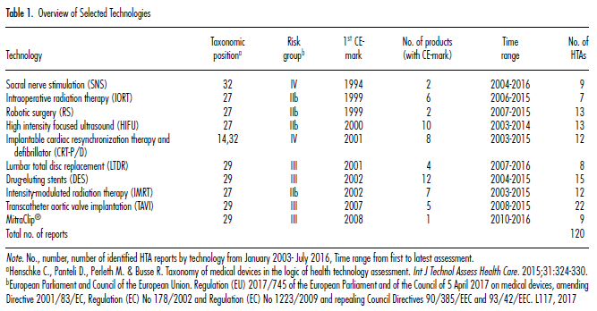


Redundancies of HTAs on „other technologies“ (medical procedures, devices..)
Hawlik, K., Rummel, P., Wild, C. (2018) Analysis of duplication and timing of health technology assessments on medical devices in Europe. Int J TAHC 34(1): 18-26.

Slide 19
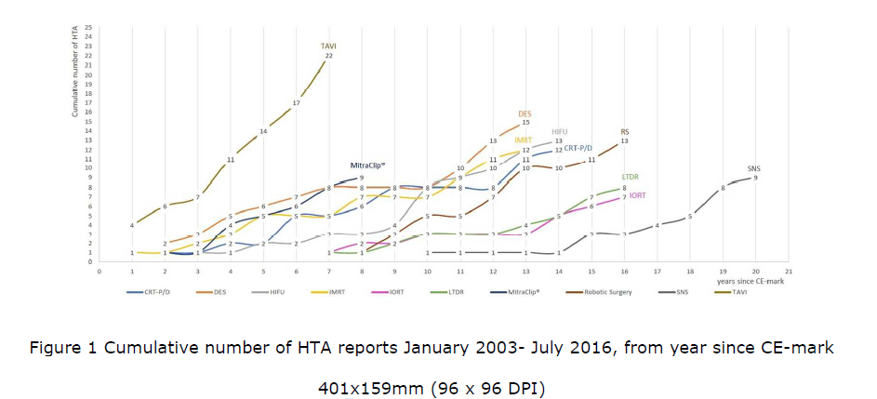

Potential for uptake over time
Source: Hawlik, K., Rummel, P., Wild, C. (2017) Analysis of duplication and timing of health technology assessments on medical devices in Europe. Int J TAHC In print.

Slide 20

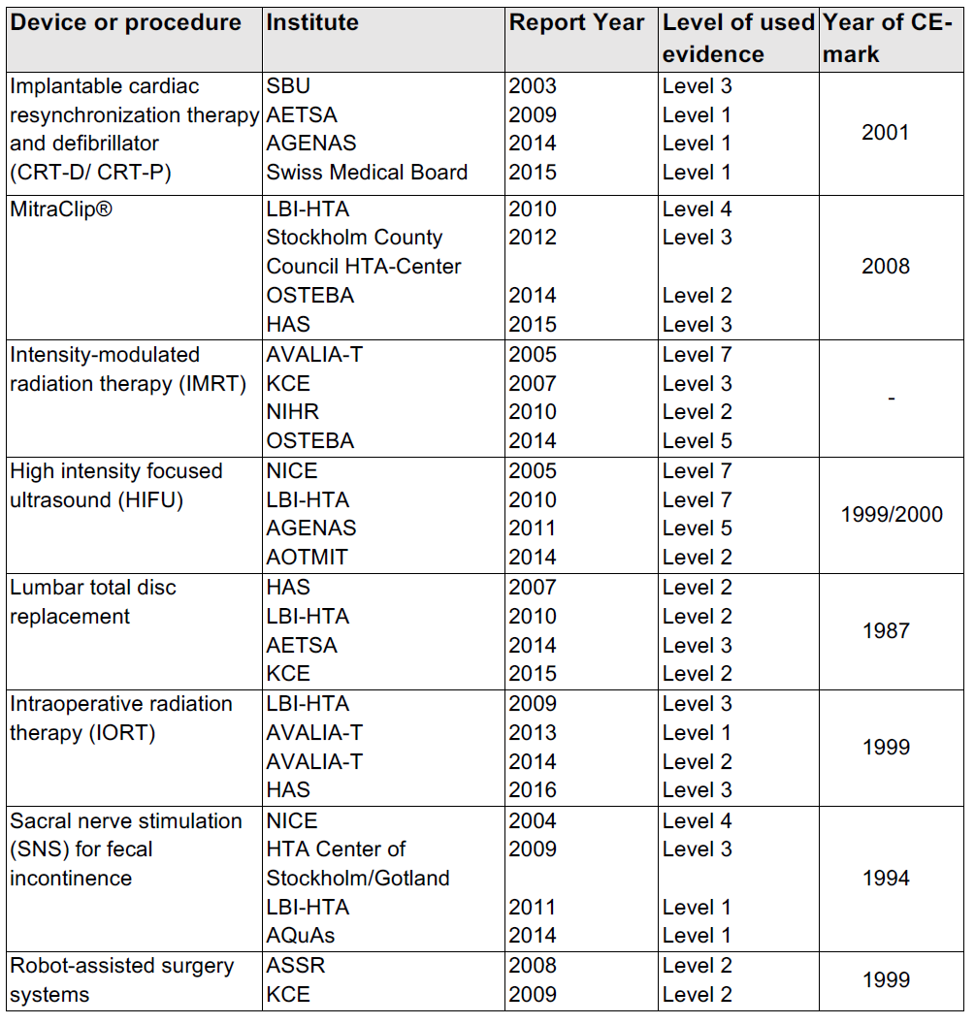
Building on each others HTAs
Use of Evidence:
Principle...the later, the higer LoE

Slide 21
Consequence: Decentral organisation:
6 Activity Centres
LBI HTA
AC Lead
AGENAS
AAZ
NIPHNO
Avalia-t
AETS-ISCIII (year 2)
HIQA (year 2)

Slide 22
Activity Centers with more/
less activities
LBI HTA:
4 CA – author
10 CA/JA - PM
AGENAS:
2 CA – author & PM
AAZ:
1 CA, 1 JA - author
1 CA - PM
NIPHNO:
1 CA – author & PM
CANCELLED
Avalia-t:
1 CA – author
1 CA - author & PM
AETS-ISCIII
HIQA:
1 CA – author & PM
1 CA - PM

Slide 23
Overview: https://www.eunethta.eu/rapid-reas/
6 published:
2 Screening/Diagnostics
4 Procedures/ MD
7 ongoing (1 cancelled)
3 before start:
3 Diagnostics
7 Procedures/ MD

Slide 24

Published assessments
ID | Title | Assessment team | Patients?
OTCA01 Nov 2016 | Wearable cardioverter-defibrillator therapy in primary and secondary prevention of sudden cardiac arrest in patients at risk | LBI-HTA/Austria, AAZ/ Croatia, IQWiG/ Germany, Avalia-t/ Spain | Focus Group
OTCA02 Apr 2017 | Antibacterial-coated sutures versus non-antibacterial-coated sutures for the prevention of abdominal, superficial and deep, surgical site infection | AAZ/ Croatia, NSPHMPDB/ Romania, SUKL/ Czech Republic, NIPN/OGYEI/ Hungary, VASPVT/ Lithuania, SNHTA/ Switzerland, IQWIG/ Germany
OTCA03 Feb 2018 | Screening of fetal aneuploidies whereby non-invasive prenatal test | Avalia-t/ Spain, RER/ Italy, MIDT /Denmark, SNHTA/Switzerland, NIPN/Hungary, IQWIG/Germany | Comment scope
OTCA04 Jan 2018 | Added value of using gene-expression signature for adjuvant chemotherapy decisions in early breast cancer (MammaPrint) | ZIN/ Netherlands, KCE/ Belgium, LBI-HTA/ Austria, HAS/ France | Scoping meeting + review
OTCA05 April 2017 | Repetitive transcranial magnetic stimulation for treatment-resistant major depression | LBI-HTA/ Austria, Osteba/ Spain, KCE/ Belgium, Funcanis/ Spain
OTCA09 April 2018 | High-intensity focused ultrasound ablation for the treatment of prostate cancer | LBI-HTA/ Austria, VASPVT/ Lithuania, SNHTA/ Switzerland, AETS-ISCIII/ Spain, OSTEBA/ Spain
Notes:
Mention website table: https://www.eunethta.eu/rapid-reas/

Slide 25
Ongoing assessments (1/2)
ID | Title (ongoing) | Assessment team | Patients?
OTCA06 June 2018 | Transcatheter aortic valve implantation in patients at intermediate surgical risk | AGENAS/ Italy, NIPHNO/ Norway, SNHTA/ Switzerland, OCSC/ Greece, HIQA/ Ireland, KCE/ Belgium, REGIONE VENETO/ Italy
OTCA07 June 2018 | Femtosecond laser-assisted cataract surgery compared to standard ultrasound phacoemulsification cataract surgery | RER/ Italy, GÖG/ Austria, HAS/ France, KCE/ Belgium, Osteba/ Spain, SESCS/FUNCANIS/ Spain, AQuAS/ Spain
OTJA08 July 2018 | Continuous glucose monitoring and flash glucose monitoring as personal, standalone systems in patients with diabetes mellitus treated with insulin | AAZ/ Croatia, HVB/ Austria, NIPHNO/ Norway, AQuAS/ Spain, HIS/ Scotland, RER/ Italy | Patient input form and focus groups
OTJA10 Jan 2019 | Stool DNA testing (e.g. ColoAlert, ColoGuard) for early detection of colorectal cancer | GÖG/ Austria, NIJZ/ Slovenia, JAZMP/ Slovenia, NICE/ UK, AGENAS/ Italy, DEFACTUM/ Denmark, OSTEBA/ Spain | Semi-structured interviews
OTCA11 Nov 2018 | The use of 3D printing for implants and splints in connection with surgery | DEFACTUM/ Denmark, Osteba/ Spain, GÖG/ Austria, KCE/ Belgium, AAZ/ Croatia, NIPN/ Hungary
Notes:
Bold: 1st author
Italic: co-author(s)
Publication date below ID

Slide 26
Ongoing assessments (2/2)
ID | Title (ongoing) | Assessment team | Patients?
OTCA12 Sept 2018 | The use of C-reactive protein point-of-care testing to guide antimicrobial prescribing in primary care settings for respiratory tract infections | HIQA/ Ireland, HVB/ Austria, UCSC Gemelli/ Italy, AETSA/ Spain, AGENAS/ Italy, HIS/ Scotland | Scoping e-meeting
OTCA13 Cancelled due to expiration of CE mark | Vagal nerve blockade for obesity | NIPHNO/ Norway, VASPVT/ Lithuania, SESCS/FUNCANIS/ Spain, NIPHB/ Romania
OTCA14 Nov 2018 | Robotic surgery in cardiovascular and visceral indications | LBI-HTA/ Austria, Regione Veneto/ Italy, HIQA/ Ireland, DEFACTUM/ Denmark
OTCA15 TBD | Irreversible electroporation in liver and pancreatic cancer | Avalia-t/ Spain Team building
OTCA16 TBD | Bioresorbable Stents in cardiovascular indications (coronary artery disease) | LBI-HTA/ Austria - IAMEV/ Austria Team building
Notes:
- Austrian Institute for General Medicine and Evidence-based Health Services Research (IAMEV)
- Bold: 1st author
- Italic: co-author(s)
- Publication date below ID
- A new call was sent out May 17 from Agenas/RER

Slide 27
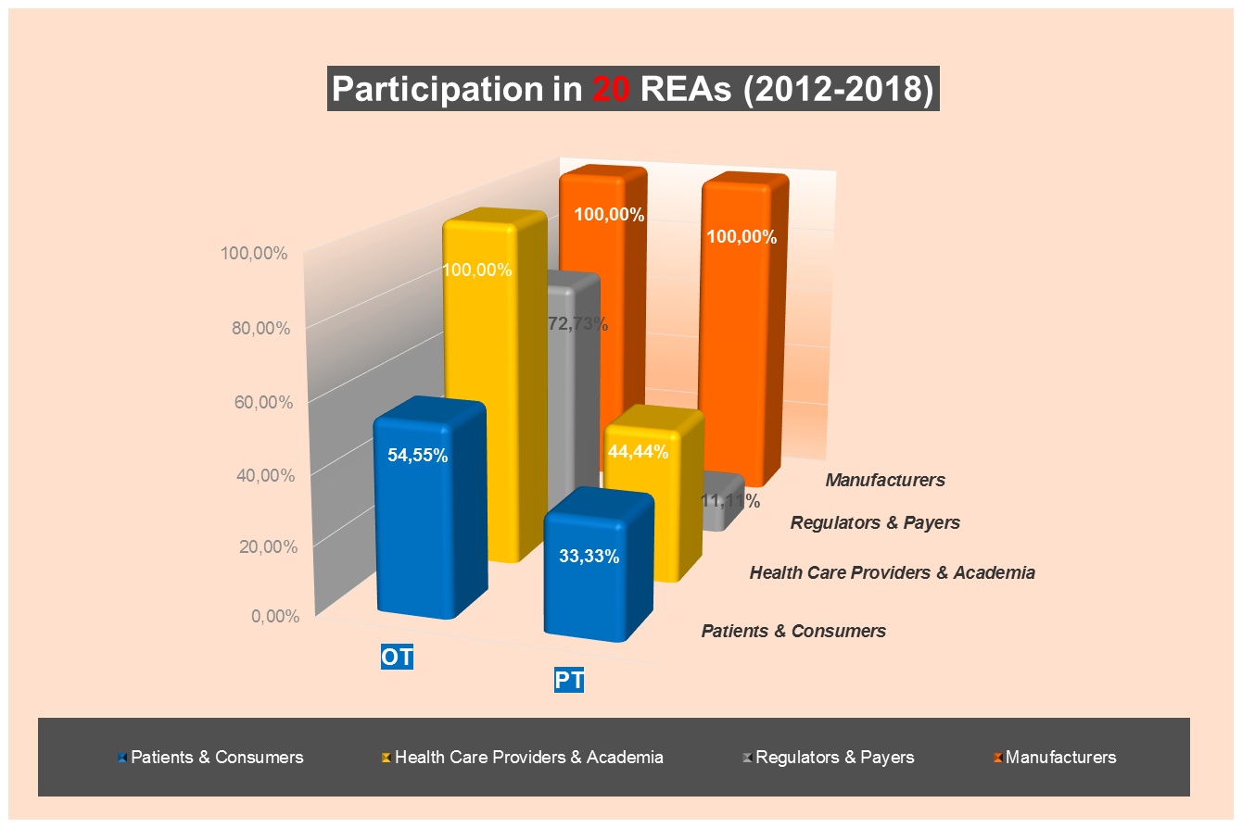

Slide 28
Austria: Efficient Ressource Use (= Efficiency Gain)
Wearable cardioverter-defibrillator
Transcranial magnetic stimulation
High intensity focused ultrasound (prostate ca)
Robotic Surgery in Cardiovascular and Visceral Indications
Bioresorbable Stents in CAD
Antibacterial-coated sutures for preventing SSI
Non-invasive prenatal testing
TAVI
Stool-DNA Testing

Slide 29

Thank you
Any questions?
Claudia.wild@hta.lbg.ac.at

Slide 30
Pharma Joint Assessment process 2.0
EUnetHTA Forum, May 25, 2018 Cologne
WP4 – Co Lead Partner Pharmaceutical Joint Assessments
Dutch National Healthcare Institute, The Netherlands,
Notes:
Title slide orange

Slide 31
Production of assessments
Evaluation of process
Refining process

Slide 32
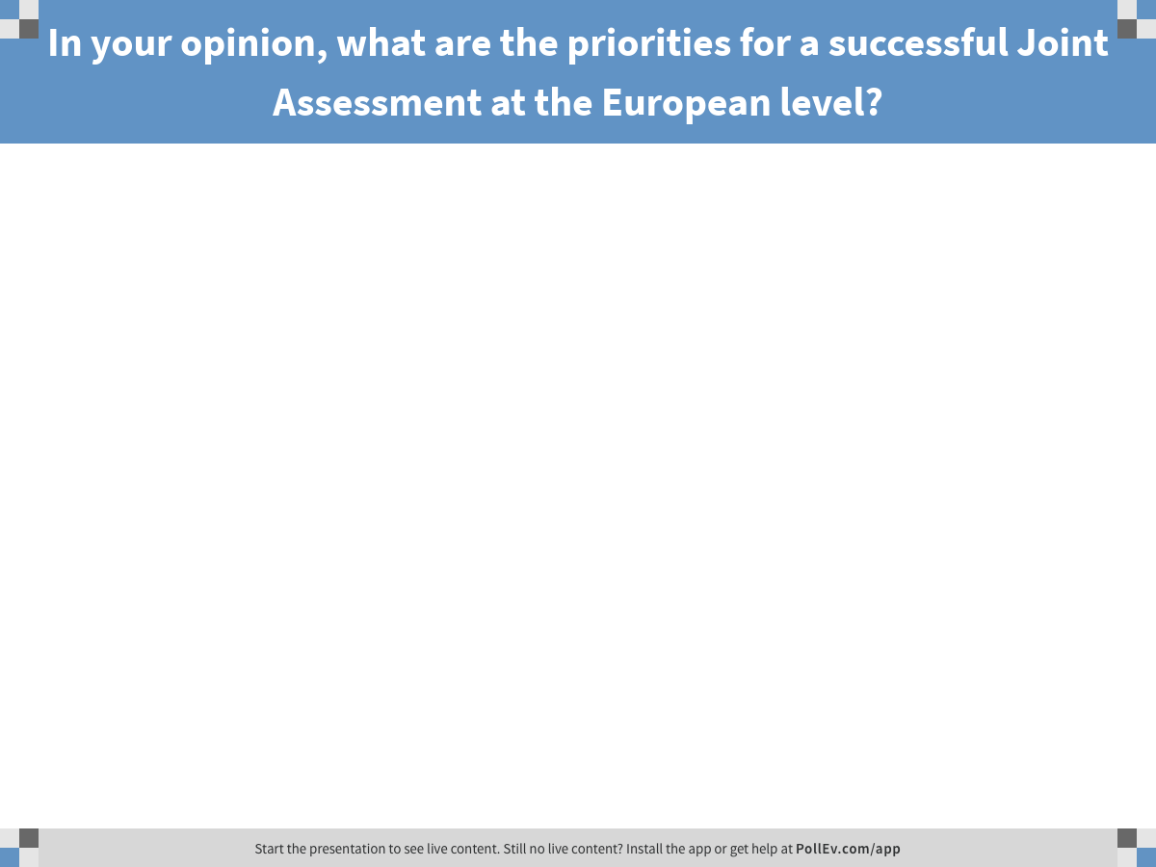
Notes:
Poll Title: In your opinion, what are the priorities for a successful Joint Assessment at the European level?
https://www.polleverywhere.com/free_text_polls/K63rnKV3BtM4no4

Slide 33
Evaluation & Revision - activity flow
Survey after publication JA
  Authoring team
  Marketing Authorisation Holder
F2F meeting (co-)authors 1st and 2nd Joint Assessment
Collaboration with WP6 on Quality Management
Notes:
Before production all pharma SOP, refine procedure
Set up group with WP4 LP, CoLP, WP6 LP and two HTA bodies
Deemed relevant to expand group for certain topics
Think of broad consultation WP4 partners
Bit more on evaluation process (how do we receive feedback and from whom).
Main changes coming
And that we do this all with the aim to facilitate implementation.

Slide 34
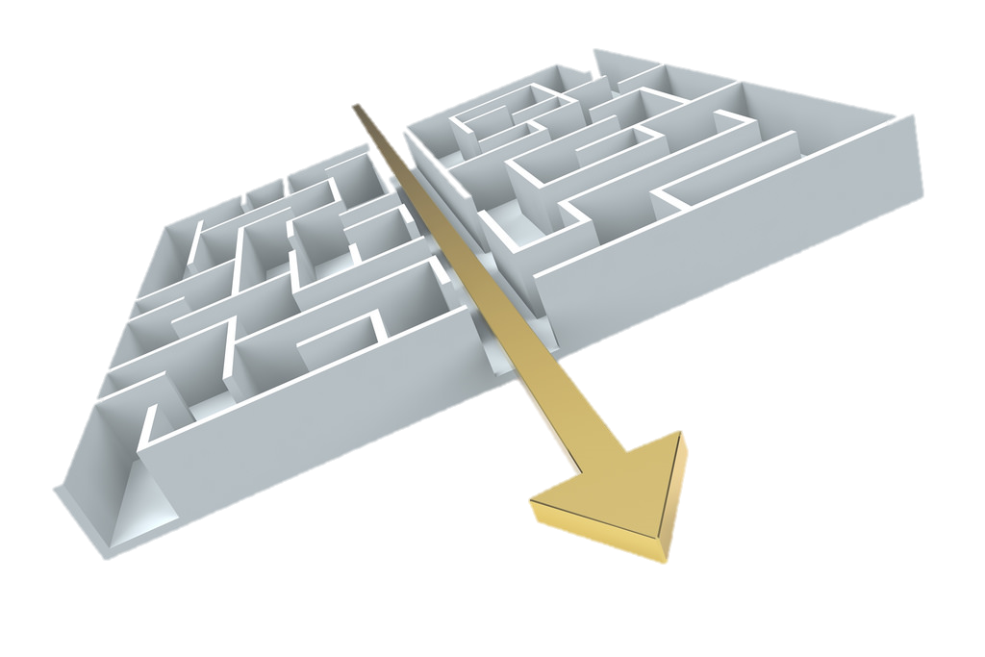
Simplify production process
Notes:
With this slide I will mention:
No more draft submission file
Extended Letter of intent
Focus on scope (PICO) and try to have as European as possible

Slide 35

Readability report
Notes:
Focus on more readable reports → e.g. structure of assessment report
Also limit overlap with EPAR → more general domains on health problem and technology can be shortened

Slide 36

Stakeholder engagement
Notes:
Will say something about EUnetHTA Task Group on Patient & Consumer, and Healthcare Provider.
Patients
Seek especially input during scoping phase
Had meetings with some EU patient organisations → dialogue on best practices
HCP
Started discussions within TG now
Will look for options to have consultation/dialogue with them as well

Slide 37
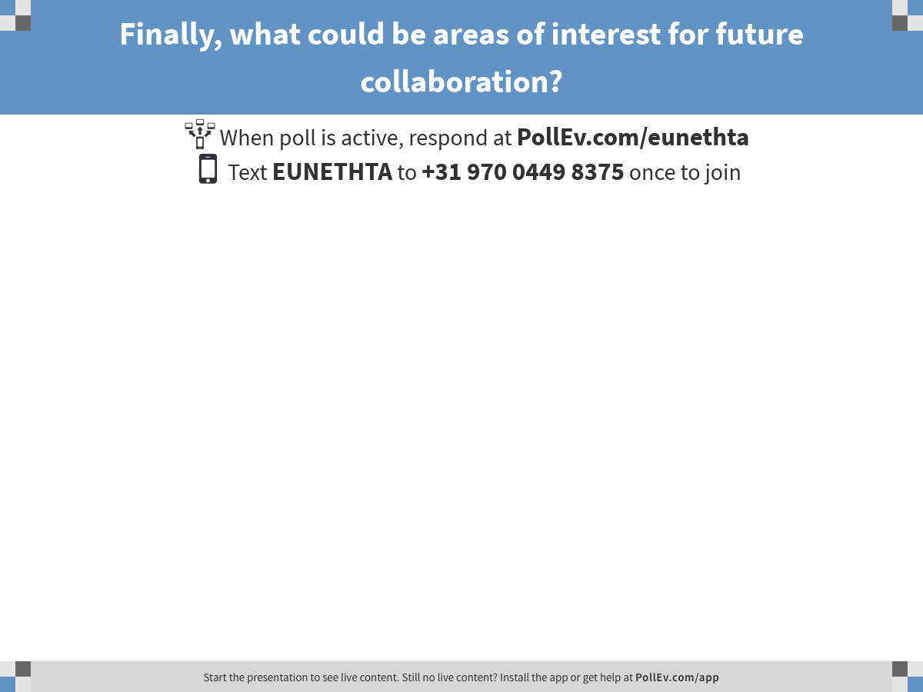
Notes:
Poll Title: Finally, what could be areas of interest for future collaboration?
https://www.polleverywhere.com/free_text_polls/jcMCQRRExUUX1tU

Slide 38

Notes:
Poll Title: What are the concerns from a pharmaceutical industry perspective regarding getting engaged with Joint Assessments?
https://www.polleverywhere.com/free_text_polls/ONoAYv8vNddFeV4

Slide 39
Thank you
Interested in submitting a compound for a JA?
Come find us or contact us on
WP4_Pharmaceuticals@zinl.nl

Slide 40
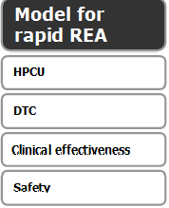

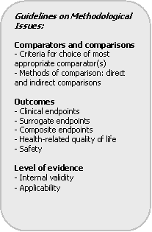
Tools & templates
Procedure manual describes processes – to be replaced by SOPs
Guidelines provide methodological guidance
+ consideration of other Core Model applications
Submission File template is submitted by manufacturer (optional for Collaborative Assessments) – to be updated in JA3
Assessment template and Project Plan template provide guidance for reporting
Provides working framework through a set of research questions*
* + checklist for ethical, organisational, social and legal issues
Notes:
Back up slide

Slide 42

WP4 pharma - Scoping Phase
Scoping F2F meeting:
Meeting with pMAH, (co-)author and coordination team.
Discuss PICO and data request from authoring team.
(co-)authors will shows how report used in national setting.
Advice pMAH to bring:
  Regulatory person
  Representative from national affiliate (co-)author
Submission file & CSR
All information in submission file is subject to be cited in the final JA report
All CSR, NMA, SAP (etc)
  Background info
  Confidential
  Request explicit written consent for citation
Confidentialiaty and COI
All individuals in the team, including patients and experts, sign our DOICU form
Coordination team assesses the forms
  Individuals with COI cannot participate
42
European network for Health Technology Assessment | JA2 2012-2015 | www.eunethta.eu
Notes:
42
25 May, 2018

Slide 43
WP4 pharma - Assessment Phase
Fact check by MAH and review experts:
Comments MAH and experts to be answered by (co-)authors and published as appendix with final report
43
European network for Health Technology Assessment | JA2 2012-2015 | www.eunethta.eu
Notes:
43
25 May, 2018

Slide 44
Quality as a Driver for Uptake of EUnetHTA‘s Work –
Update on WP6 Activities
Miriam Luhnen, IQWiG (Germany), WP6 Lead

Slide 45
WP6 – Main Objectives
Improve quality and efficiency of joint work and favour its adaptation at national and on EU level through systematic development and establishment of a quality management system already in place for the sustainable network after 2020
Support EUnetHTA partners through provision and development of necessary tools and methodologies for joint work
Increase capacity and know-how in HTA-bodies by developing and providing training for quality management and methodologies and tools in the context of EUnetHTA

Slide 46
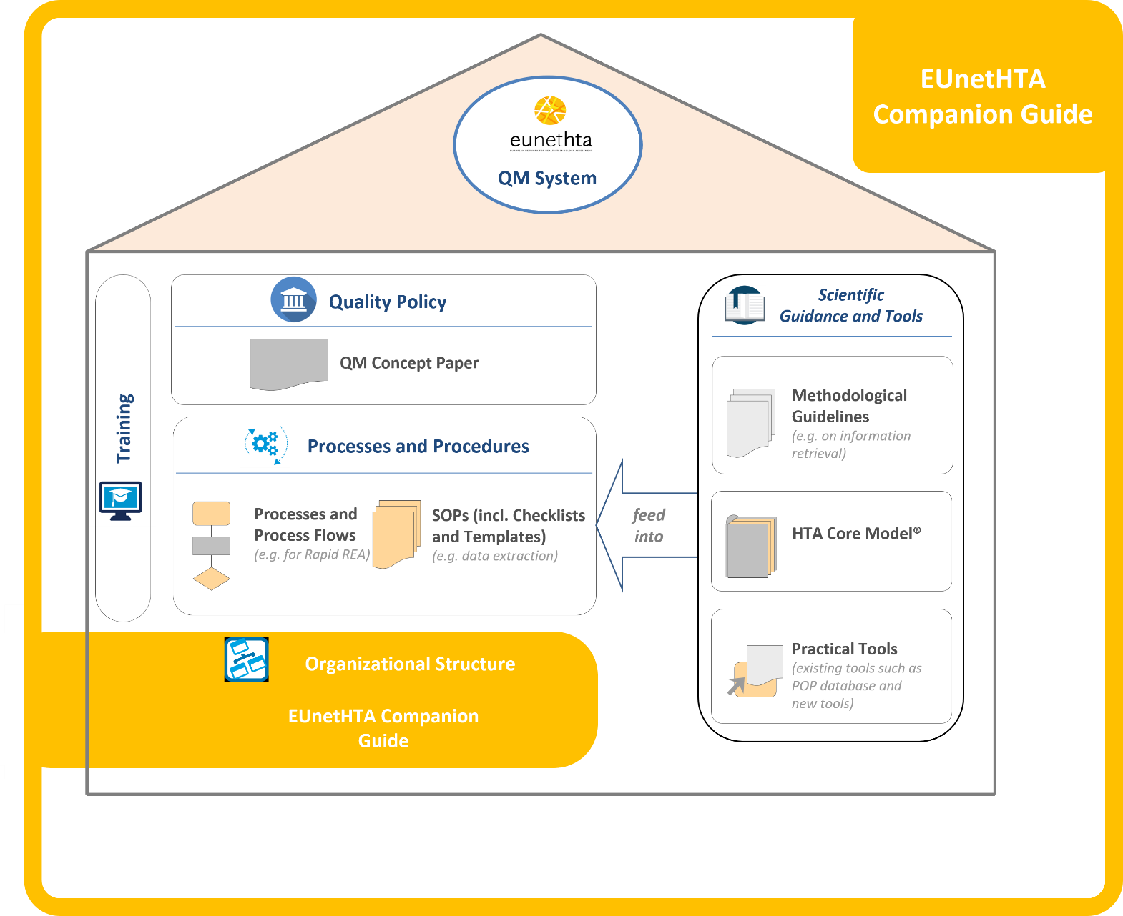


EUnetHTA‘s Quality Management System
Activity Centre A
Quality Management
led by IQWiG
Activity Centre B
Sci. Guidance and Tools
led by KCE
Notes:
Quality Policy: EUnetHTA formulated its current corporate mission in May 2012 with the “EUnetHTA Strategy 2012 and beyond”, endorsed by the EUnetHTA Plenary Assembly. Common strategies were defined as:
• to increase collaborative production of HTA core information and to facilitate its use in national reporting,
• to increase reliability and relevance of HTAs by supporting high quality, robust and relevant information for decision making,
• to produce additional evidence and reduce redundancy by the usage of implemented common tools and by the effort to further implement and disseminate tools and guidelines in the work of national HTA organisations.
• to establish essential collaboration with the international HTA community, regulatory bodies and other relevant organisations as well as to refine roles and tasks of stakeholders (in terms of Stakeholder Forum and Stakeholder Advisory Groups in JA2) to increase the relevance of HTA.

Slide 47
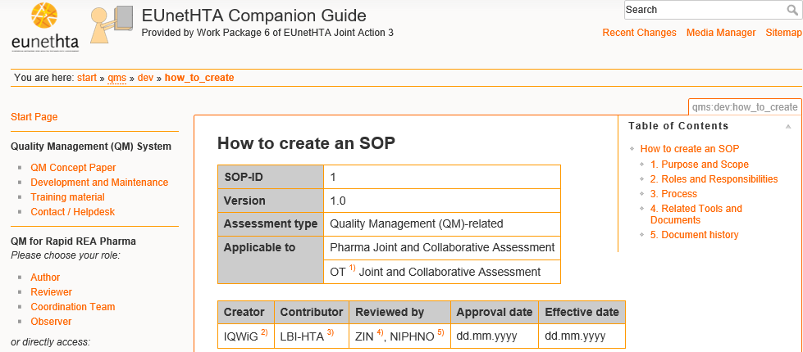
WP6 Activity Centre A:
Quality Management System
Development of SOPs
Processes and
Process Flows
(e.g. for Rapid REA)
SOPs (incl. Checklists
and Templates)
(e.g. data extraction)
SOPs describing all process steps of Rapid REA Pharma and OT
Project Start e.g. Topic Selection, Identification of Stakeholders
Scoping and Developing Project Plan e.g. Internal and External Review Project Plan
Assessment Phase e.g. Information Retrieval, Data Extraction, Data Analysis
Finalisation of Assessment Publication and Dissemination of Assessments
Development and Maintenance of SOPs and Guidelines
Notes:
Development of 40 SOPs on all process steps

Slide 48
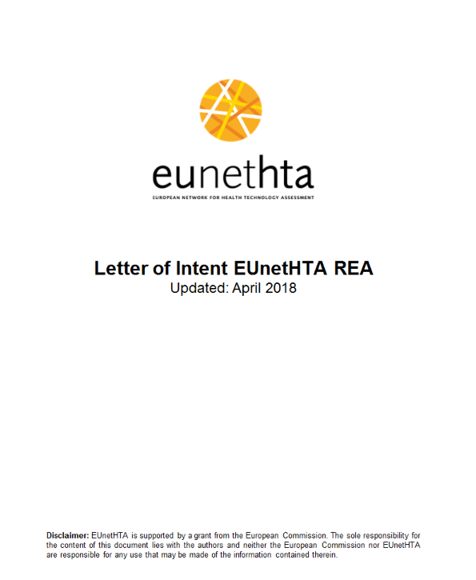
WP6 Activity Centre A:
Quality Management System
Revision of Documents and Templates
Processes and
Process Flows
(e.g. for Rapid REA)
SOPs (incl. Checklists
and Templates)
(e.g. data extraction)
Joint Group on the Rapid REA Pharma Process
Letter of Intent
Submission requirements
Project Plan Template
Submission File Template
Assessment Report Template
Notes:
Joint Group: WP4 + WP6 + national experts from WP5 and WP7

Slide 49
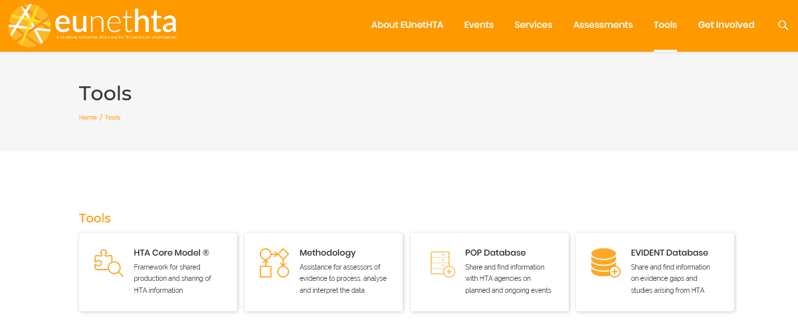
WP6 Activity Centre B:
Scientific Guidance and Tools
Development and Revision of Tools
Methodological
Guidelines
(e.g. on information retrieval)
Practical Tools
(existing tools such as POP database and new tools)

Slide 50
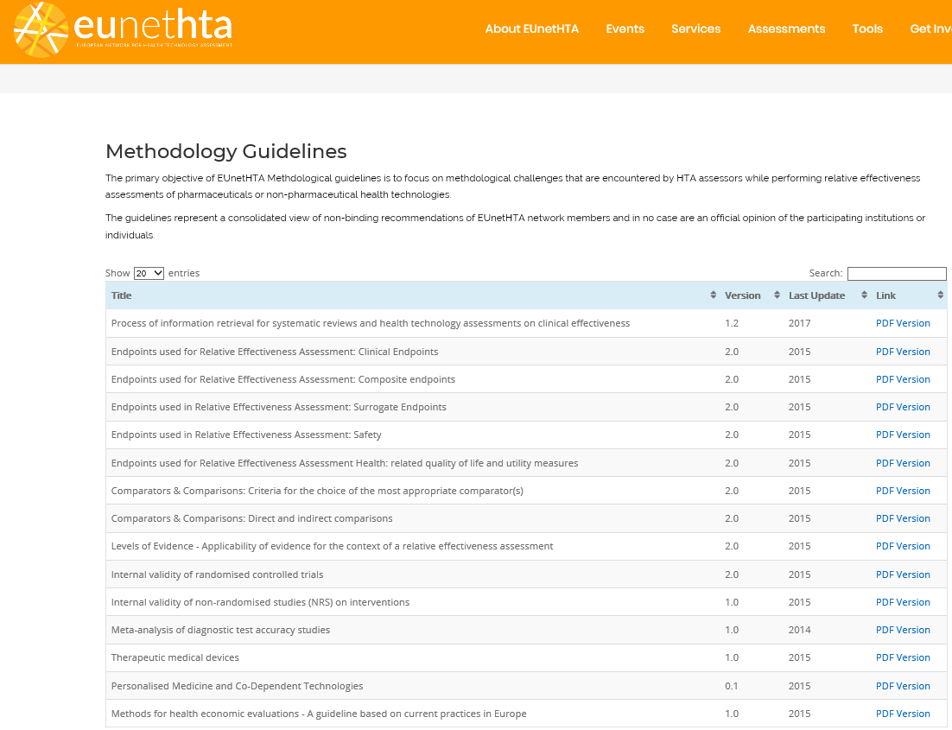
WP6 Activity Centre B:
Scientific Guidance and Tools
Development and Revision of Guidelines
Methodological
Guidelines
(e.g. on information retrieval)

Slide 51
WP6 Activity Centre B:
Scientific Guidance and Tools
Development and Revision of Guidelines
Methodological
Guidelines
(e.g. on information retrieval)
Title | Status | Publication
Process of information retrieval for systematic reviews and health technology assessments on clinical effectiveness | Revised | 2017
Comparators & Comparisons: Direct and indirect comparisons | Under Revision | 2018
Critical assessment of economic evaluations | Under development | 2018
Critical assessment of clinical evaluations | Under development | 2019

Slide 52
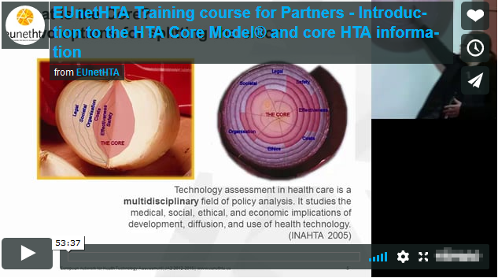

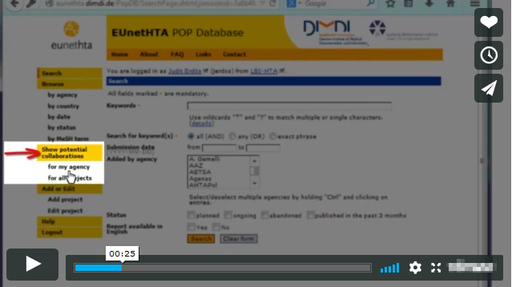
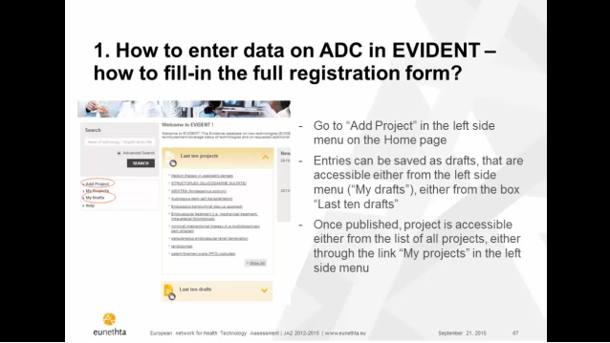
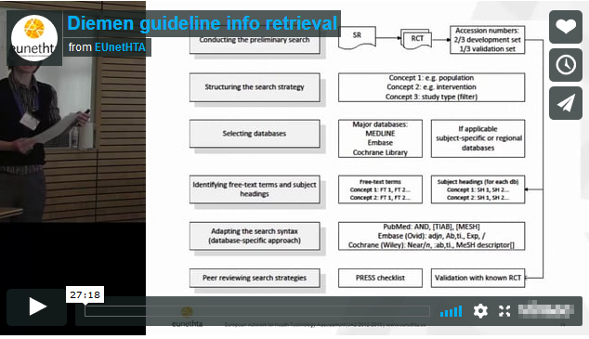

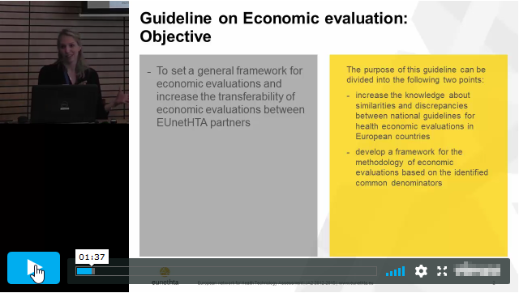
WP6-related Training Activities
Development and Revision of Training Modules
Training Activities
(on how to apply QM measures and use tools and methodology)
Notes:
Planned: Developement of Training for QM Concept, use of Companion Guide, newly developed/updated guidelines and tools

Slide 53
Thank you
Any Questions?

